Slide 1
Integrating Irrational Behavior into Agent-Based Financial Models
By: Alex Chang

Slide 2

The Problem
One way to model dynamic systems is with agent-based modeling (ABM)
However, the research which has applied ABM to financial systems has always assumed completely rational agents.

Slide 3
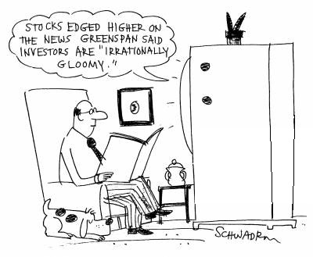
The Solution
To make ABMs more accurate for financial modeling, irrational (emotional) factors will be taken into account when determining agent behavior.
These factors will include personality traits
such as risk tolerance, contrarianism, adaptability,
optimism, reactionism

Slide 4
The Model
The model will be implemented in Python, with the Project Mesa framework for agent-based modelling.
Initial Conditions
The Model
Final Conditions
Stock Price
Buy Orders
Stock Price
Agent Population
Market
Trading Volume
Sell Orders
Previous Performance
Trading Volume

Slide 5

Performance Analysis
A variety of different populations will then be generated, with some containing a higher percentage of irrational agents than others.
The performance of each population will be analyzed, and the most accurate population will then be compared to similar agent-based models which did not account for irrational behavior.

